Slide 1
Http protocols

Slide 2
TCP/IP (Transmission Control Protocol / Internet Protocol)
The TCP/IP model defines how devices should transmit data between them and enables communication over networks and large distances.
The model represents how data is exchanged and organized over networks.
It is split into four layers, which set the standards for data exchange and represent how data is handled and packaged when being delivered between applications, devices, and servers.
Layers: Datalink Layer, Internet Layer, Transport Layer, Application Layer

Slide 3
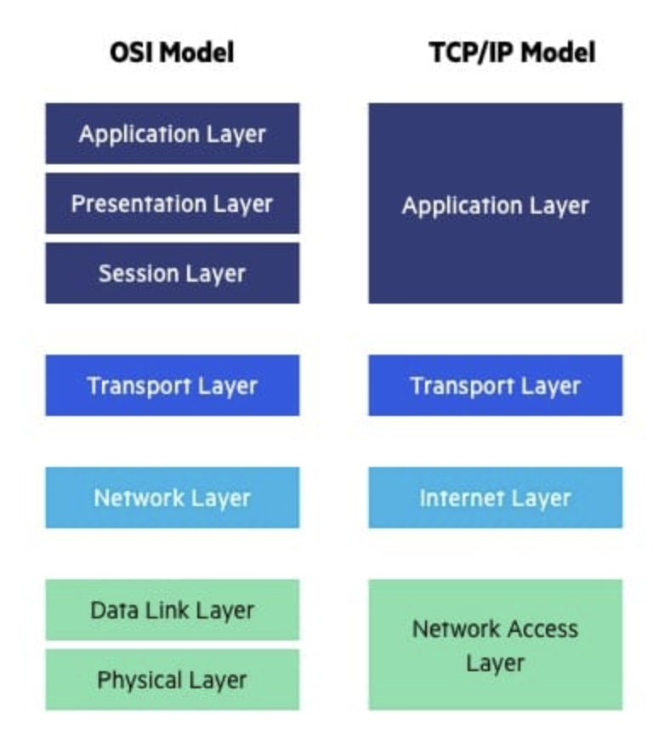
Representation of TCP/IP model and OSI Model

Slide 4
Application Layer
Application layer: The application layer refers to programs that need TCP/IP to help them communicate with each other. This is the level that users typically interact with, such as email systems and messaging platforms. It combines the session, presentation, and application layers of the OSI model.
https://javaadpatel.com/networking-osi-for-backend-engineers/

Slide 5
HTTP
Hypertext Transfer Protocol.
Hypertext Transfer Protocol is a set of rule which is used for transferring the files like, audio, video, graphic image, text and other multimedia files on the WWW (World Wide Web).
HTTP is an application-level protocol. The communication usually takes place through TCP/IP sockets, but any reliable transport can also be used.
The standard (default) port for HTTP connection is 80, but other port can also be used.
The first version of HTTP was HTTP/0.9, which was introduced in 1991.
The latest version of HTTP is HTTP/3, which was published in September 2019.
HTTP is a protocol that is used to transfer the hypertext from the client end to the server end, but HTTP does not have any security.

Slide 6
Https
Hypertext Transfer Protocol Secure
HTTPS is used to encrypt or decrypt HTTP page or HTTP page requests that are returned by the webserver.
In HTTPS, the standard port to transfer the information is 443.
HTTPS protocol uses HTTP on connection encrypted by SSL (Secure Socket Layer) or TLS (Transport Layer Security).
It is the default protocol for conducting financial transactions on the web.

Slide 7
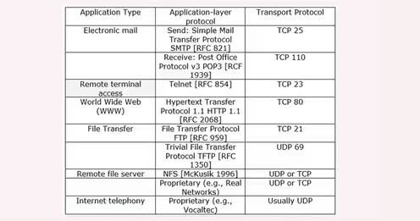
Application level protocols

Slide 8
HTTP/0.9 — The One-line Protocol
Initial version of HTTP — a simple client-server, request-response, telenet-friendly protocol
Request nature: single-line (method + path for requested document)
Methods supported: GET only
Response type: hypertext only
Connection nature: terminated immediately after the response
No HTTP headers (cannot transfer other content type files), No status/error codes, No URLs, No versioning

Slide 9
Http 1.0
Browser-friendly protocol
Provided header fields including rich metadata about both request and response (HTTP version number, status code, content type)
Response: not limited to hypertext (Content-Type header provided ability to transmit files other than plain HTML files — e.g. scripts, stylesheets, media)
Methods supported: GET , HEAD , POST
Connection nature: terminated immediately after the response

Slide 10
Http 1.1
Host header: HTTP 1.0 does not officially require the host header. HTTP 1.1 requires it by the specification. The host header is specially important to route messages through proxy servers, allowing to distinguish domains that point to the same IP
Persistent connections: in HTTP 1.0, each request/response pair requires opening a new connection. In HTTP 1.1, it is possible to execute several requests using a single connection
Continue status: to avoid servers refusing unprocessable requests, now clients can first send only the request headers and check if they receive a continue status code (100)
New methods: besides the already available methods of HTTP 1.0, the 1.1 version added six extra methods: PUT, PATCH, DELETE, CONNECT, TRACE, and OPTIONS

Slide 11
Http 2.0
Request multiplexing: HTTP 1.1 is a sequential protocol. So, we can send a single request at a time. HTTP 2.0, in turn, allows to send requests and receive responses asynchronously. In this way, we can do multiple requests at the same time using a single connection
Request prioritization: with HTTP 2.0, we can set a numeric prioritization in a batch of requests. Thus, we can be explicit in which order we expect the responses, such as getting a webpage CSS before its JS files
Automatic compressing: in the previous version of HTTP (1.1), we must explicitly require the compression of requests and responses. HTTP 2.0, however, executes a GZip compression automatically
Connection reset: a functionality that allows closing a connection between a server and a client for some reason, thus immediately opening a new one
Server push: to avoid a server receiving lots of requests, HTTP 2.0 introduced a server push functionality. With that, the server tries to predict the resources that will be requested soon. So, the server proactively pushes these resources to the client cache

Slide 12
Request Multiplexing
HTTP/1.1 with one connection - Browser will make a request to server then wait for its response before sending another request.
Ex. So your browser downloads the HTML, then it asks for the CSS file. When that's returned it asks for the JavaScript file. When that's returned it asks for the first image file... etc. HTTP/1.1 is basically synchronous - once you send a request you're stuck until you get a response.
To get around this, with HTTP/1.1, browsers usually open multiple connections to the web server (typically 6).
This means a browser can fire off multiple requests at the same time, which is much better, but at the cost of the complexity of having to set-up and manage multiple connections. Note: Here also, the server will respond to those request in the same order.

Slide 13
Request Multiplexing
HTTP/2 allows you to send off multiple requests on the same connection. So your browser can say "Gimme this CSS file. Gimme that JavaScript file. Gimme image1.jpg. Gimme image2.jpg... Etc."
All request reach server almost parallelly. Server can respond to those request in any order. Also, server can even break each file requested into pieces and intermingle the files together.
This has the secondary benefit of one heavy request not blocking all the other subsequent requests (known as the head of line blocking issue). Web browser then puts all pieces back together.
Bandwidth is rarely a problem compared to Delays in actually sending the packages across and back. Sometimes server has to leave some part of file as packages as bandwidth is less.

Slide 14
Scheme: Protocol (http/https/ftp/smtp)
Subdomain: A subdomain is a prefix added to a domain name to separate a section of your website.(ex. http://blog.csuf.co.in)
Domain: Domain name specifies the organization or entity that the URL belongs to
TDL: The TLD (top-level domain) indicates the type of organization the website is registered to. Like the .com in www.facebook.com indicates a commercial entity. Similarly, .org indicates organization, .co.uk a commercial entity in the UK.
Port: A port number specifies the type of service that is requested by the client since servers often deliver multiple services.
Path: Path specifies the exact location of the web page, file, or any resource that the user wants access to

Slide 15
Separator: The query string which contains specific parameters of the search is preceded by a question mark (?). The question mark tells the browser that a specific query is being performed.
Query String: The query string specifies the parameters of the data that is being queried from a website’s database. Each query string is made up of a parameter and a value joined by the equals (=) sign. In case of multiple parameters, query strings are joined using the ampersand (&) sign. The parameter can be a number, string, encrypted value, or any other form of data on the database
Fragment: The fragment identifier of a URL is optional, usually appears at the end, and begins with a hash (#). It indicates a specific location within a page such as the ‘id’ or ‘name’ attribute for an HTML element.

Slide 16
Http codes and Error Messages
Success Codes
100-199 - Success, Request has not ended and it continues - Informational
(ex. 100 - continue, 102 - processing)
200-299 - Success, request completed (ex. 200 - OK, 201 - Created, 202- Accepted)
300-399 - success, redirection (ex. 300 - multiple choice, 301 - moved permenently)
Error Codes
400 - 499 - client side failure (ex. Wrong url request) - can be retried and gets fixed
500-599 - server side failure (500 - internal server error) - can’t retry, server side issues
https://en.wikipedia.org/wiki/List_of_HTTP_status_codes

Slide 17
Http Methods
GET (Retrieve/download): The GET method is used to retrieve information from the given server using a given URL. Requests using GET should only retrieve data and should have no other effect on the data.
POST (Create/upload): A POST request is used to send data to the server, for example, customer information, file upload, etc. using HTML forms.
PUT (update/ change existing): Replaces all current representations of the target resource with the uploaded content
DELETE: Removes all current representations of the target resource given by a URL
HEAD: Same as GET, but transfers the status line and header section only.
The HEAD method is used to ask only for information about a document, not for the document itself. HEAD is much faster than GET, as a much smaller amount of data is transferred. It's often used by clients who use caching, to see if the document has changed since it was last accessed.

Slide 18
CONNECT : Establishes a tunnel to the server identified by a given URL.
For example, the CONNECT method can be used to access websites that use SSL (HTTPS). The client asks an HTTP Proxy server to tunnel the TCP connection to the desired destination. The server then proceeds to make the connection on behalf of the client. Once the connection has been established by the server, the Proxy server continues to proxy the TCP stream to and from the client.
OPTIONS: Describes the communication options for the target resource. The response may include an Allow header indicating allowed HTTP methods on the resource, or various Cross Origin Resource Sharing headers.
TRACE: Performs a message loop-back test along the path to the target resource. The HTTP TRACE method is designed for diagnostic purposes. If enabled, the web server will respond to requests that use the TRACE method by echoing in its response the exact request that was received.

Slide 19
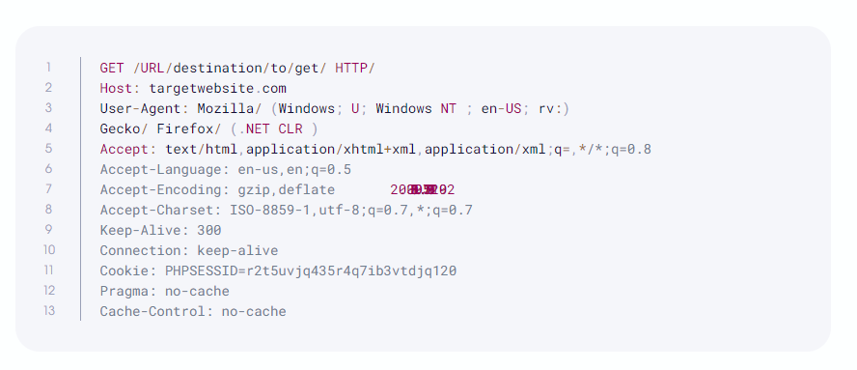
Examples of Http Headers

Slide 20
Host: The domain name of the server (used to determine the server with virtual hosting), and the TCP port number on which the server is listening. If the port is omitted, 80 is assumed. This is a mandatory HTTP request header
Accept: The media type/types acceptable
Accept-Language: (ex. Accept-Language: en-US)- List of acceptable languages
Accept-Encoding: list of types of acceptable encoding
Accept-charset: list of acceptable character set (ex. UTF-8)
User Agent: The User-Agent request header is a characteristic string that lets servers and network peers identify the application, operating system, vendor, and/or version of the requesting user agent.
Connection: a general header that controls if network connection stays open after the current transaction finishes. (ex. keep-alive)
Keep-Alive: allows the client to indicate how the connection may be used to set a maximum amount of requests and a timeout. For this header to be valid, the connection header must be set to: Keep-Alive.
Proxy-Authorization: a request header that includes the credentials to authenticate a user agent to a proxy server
Refer to the link to know more about different types of headers: https://flaviocopes.com/http-request-headers

Slide 21
REST APIs

Slide 22
API
Application Programming Interface
collection of communication protocols and subroutines used by various programs to communicate between them
It takes the request from the user and sends it to the service provider and then again sends the result generated from the service provider to the desired user.
Types -
Open APIs – public APIs which are available to any other users
Internal APIs - designed for the internal use of the company rather than the external users
Composite APIs – APIs that combines different data and services. The main reason to use Composites APIs is to improve the performance and to speed the execution process and improve the performance of the listeners in the web interfaces.
Partner APIs – APIs in which a developer needs specific rights or licenses in order to access. Partner APIs are not available to the public.

Slide 23
Try out HTTP requests
https://gorest.co.in/
https://httpbin.org/#/
https://documenter.getpostman.com/view/4016432/RWToRJCq#intro
https://jsonplaceholder.typicode.com/
https://restful-booker.herokuapp.com/
https://petstore.swagger.io/
https://fakerestapi.azurewebsites.net/index.html
https://reqres.in/
https://dummy.restapiexample.com/
Google API’s https://developers.google.com/maps/documentation

Slide 24
Same origin policy
The same-origin policy is a web browser security mechanism that aims to prevent websites from attacking each other.
The same-origin policy restricts scripts on one origin from accessing data from another origin.
When a browser sends an HTTP request from one origin to another, any cookies, including authentication session cookies, relevant to the other domain are also sent as part of the request. This means that the response will be generated within the user's session, and include any relevant data that is specific to the user. Without the same-origin policy, if you visited a malicious website, it would be able to read your emails from GMail, private messages from Facebook, etc.
Ex. http://normal-website.com/example/example.html
URL accessed Access permitted?
http://normal-website.com/example/ Yes: same scheme, domain, and port
http://normal-website.com/example2/ Yes: same scheme, domain, and port
https://normal-website.com/example/ No: different scheme and port
http://en.normal-website.com/example/ No: different domain
http://normal-website.com:8080/example/ No: different port*

Slide 25
CORS
Cross-Origin Resource Sharing (CORS) is an HTTP-header based mechanism that allows a server to indicate any origins (domain, scheme, or port) other than its own from which a browser should permit loading resources.
CORS also relies on a mechanism by which browsers make a "preflight" request (OPTIONS Request) to the server hosting the cross-origin resource, in order to check that the server will permit the actual request. In that preflight, the browser sends headers that indicate the HTTP method and headers that will be used in the actual request.
It is an OPTIONS request, using three HTTP request headers: Access-Control-Request-Method, Access-Control-Request-Headers, and the Origin header.
A preflight request is automatically issued by a browser and in normal cases, front-end developers don't need to craft such requests themselves.

Slide 26
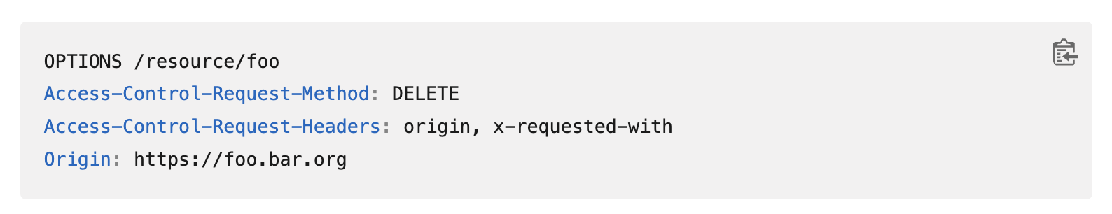
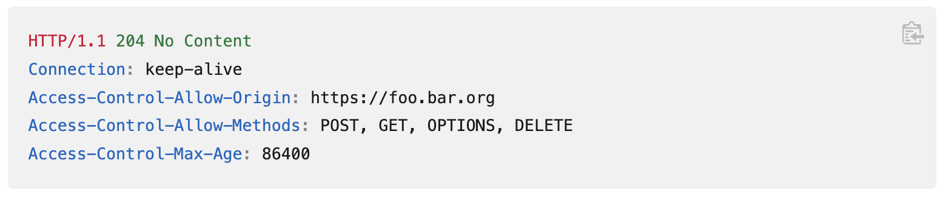
For example, a client might be asking a server if it would allow a DELETE request, before sending a DELETE request, by using a preflight request:
If the server allows it, then it will respond to the preflight request with an Access-Control-Allow-Methods response header, which lists DELETE:

Slide 27
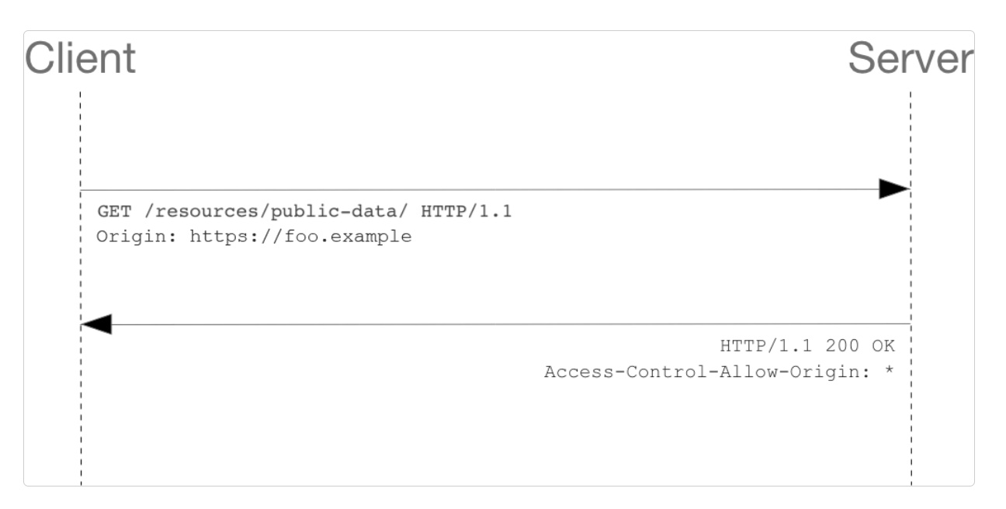
( * ) - Allows requests from any origin to access resources

Slide 28
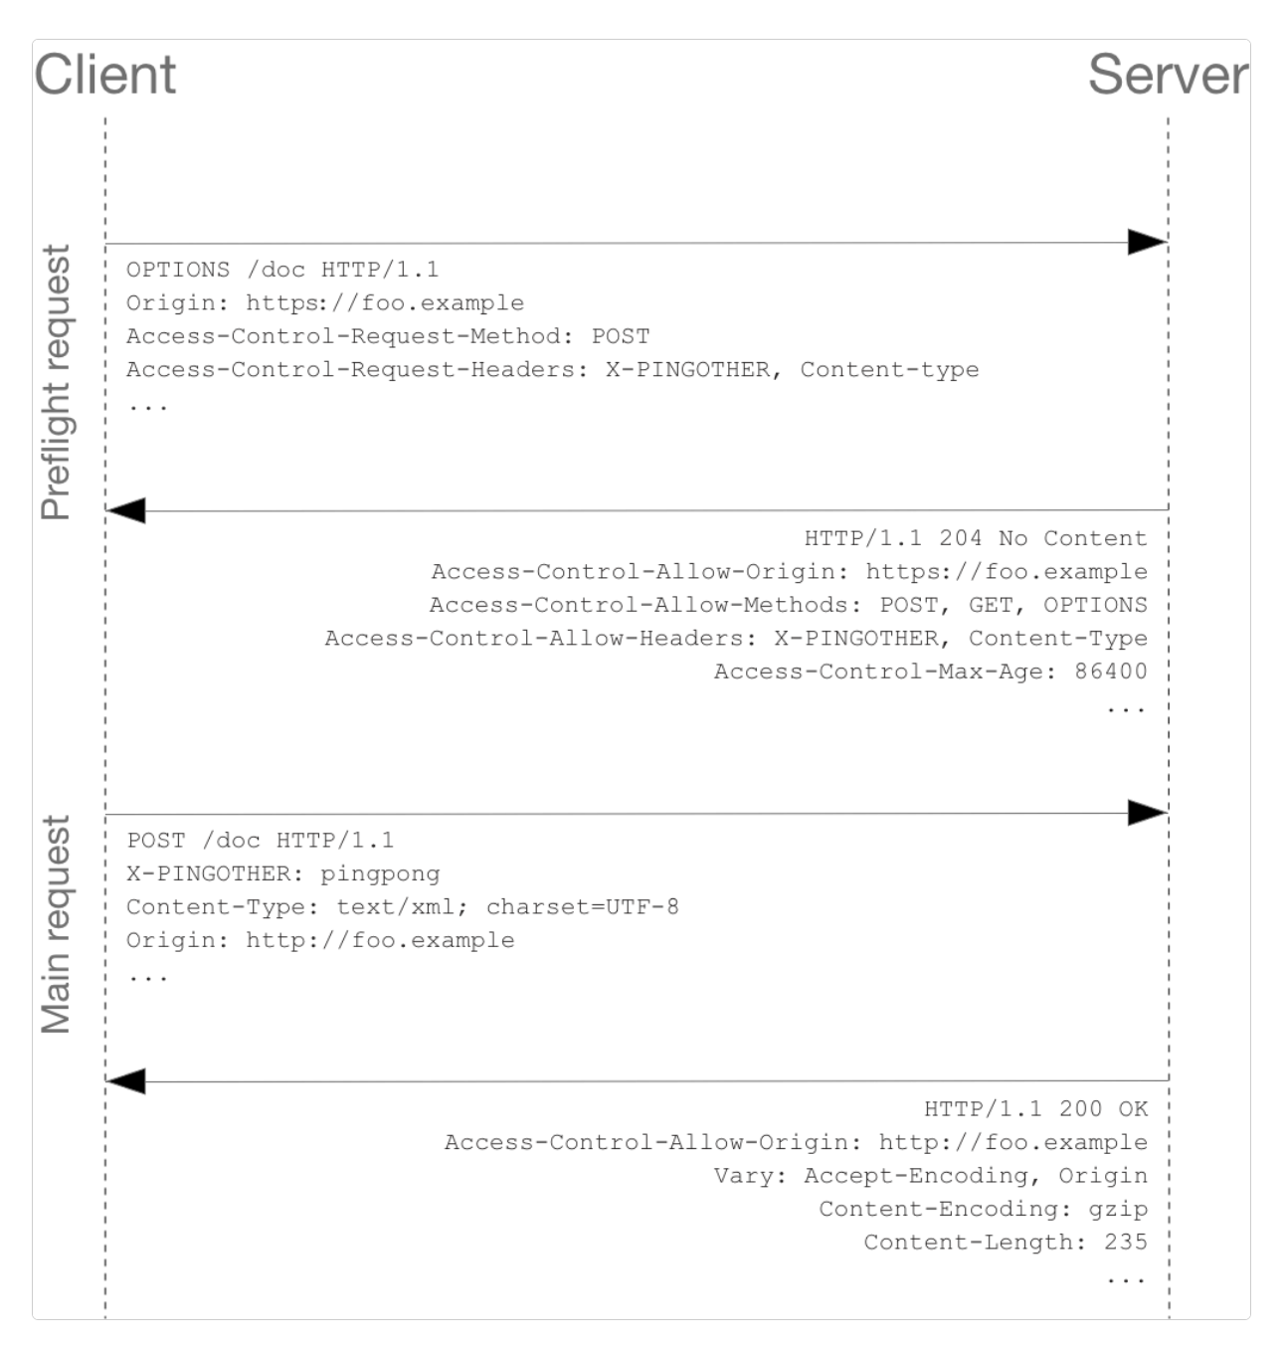
Access restricted to origin: http://foo.example

Slide 29
Comparing API architectural styles
APIs exchange commands and data, and this requires clear protocols and architectures -- the rules, structures and constraints that govern an API's operation.
Today, there are the popular categories of API architectural styles:
REST (Representational State Transfer)
SOAP (Simple Object Access Protocol)
RPC(Remote Procedure Call)
GraphQL
Falcor
https://www.altexsoft.com/blog/soap-vs-rest-vs-graphql-vs-rpc/

Slide 30
Remote Procedure Call (RPC)
The remote procedure call (RPC) protocol is a simple means to send multiple parameters and receive results
A remote procedure call is an interprocess communication technique that is used for client-server based applications. It is also known as a subroutine call or a function call.
RPC can employ two different languages, JSON and XML, for coding; these APIs are dubbed JSON-RPC and XML-RPC
Although you may have heard these terms used interchangeably, RPCs and APIs are two distinct things. APIs essentially represent the framework that enables remote computers in a shared network to communicate with one another, whereas the RPCs (or calls) are the means by which they communicate.
In other words, the calls represent the communication itself, but an API defines these calls, functionally explaining how to use them in that particular network.

Slide 31
SOAP
The simple object access protocol
SOAP is a format for sending and receiving messages
It is a messaging standard defined by the World Wide Web Consortium and broadly used to create web APIs, usually with XML.
SOAP supports a wide range of communication protocols found across the internet, such as HTTP, SMTP and TCP/IP.
The SOAP approach defines how the SOAP message is processed, the features and modules included, the communication protocol(s) supported and the construction of SOAP messages.
Compared with the flexibility of REST, SOAP is a highly structured, tightly controlled and clearly defined standard. For example, SOAP messages can contain up to four components, including an envelope, header, body and fault -- the latter used for error handling.

Slide 32
GraphQL
This style is used for querying databases from client-side applications over HTTP. But, instead of sending several HTTP requests to different endpoints, you can POST a single “query” for all you need. In essence, the client describes what they need once, and the API does its best to retrieve that data.
A server operating under the GraphQL architecture has a pre-made model (or schema) for the data that can be requested. So, when you make a request, the schema acts as a guideline on what you can ask for, how the information should be structured, and how you can interact with the server.
In REST APIs, each endpoint will return a specific payload of JSON data. Even if we only need certain fields, it will return everything on every request.
Here in GraphQL, The API returns a JSON with the exact data we wanted. No more, no less. This is the beauty of GraphQL

Slide 33
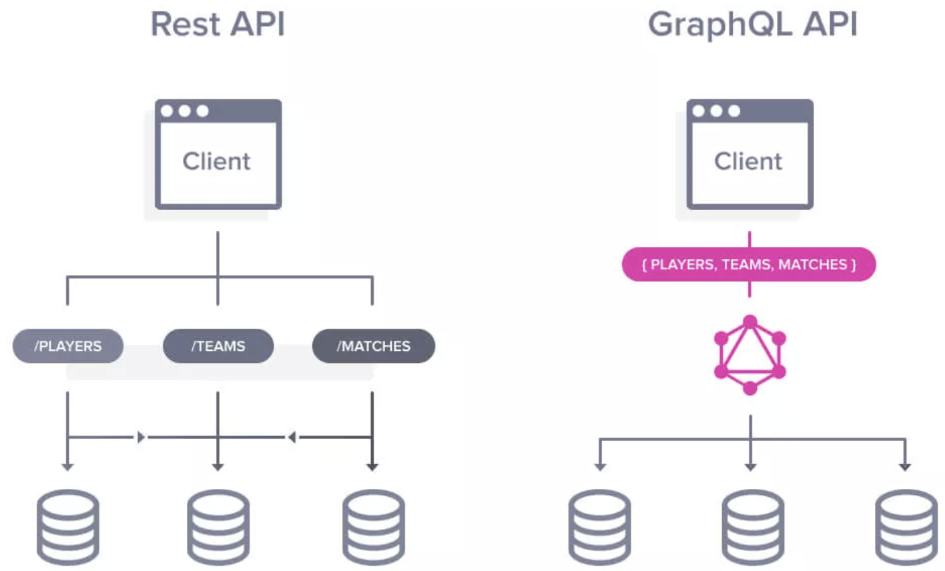

Slide 34
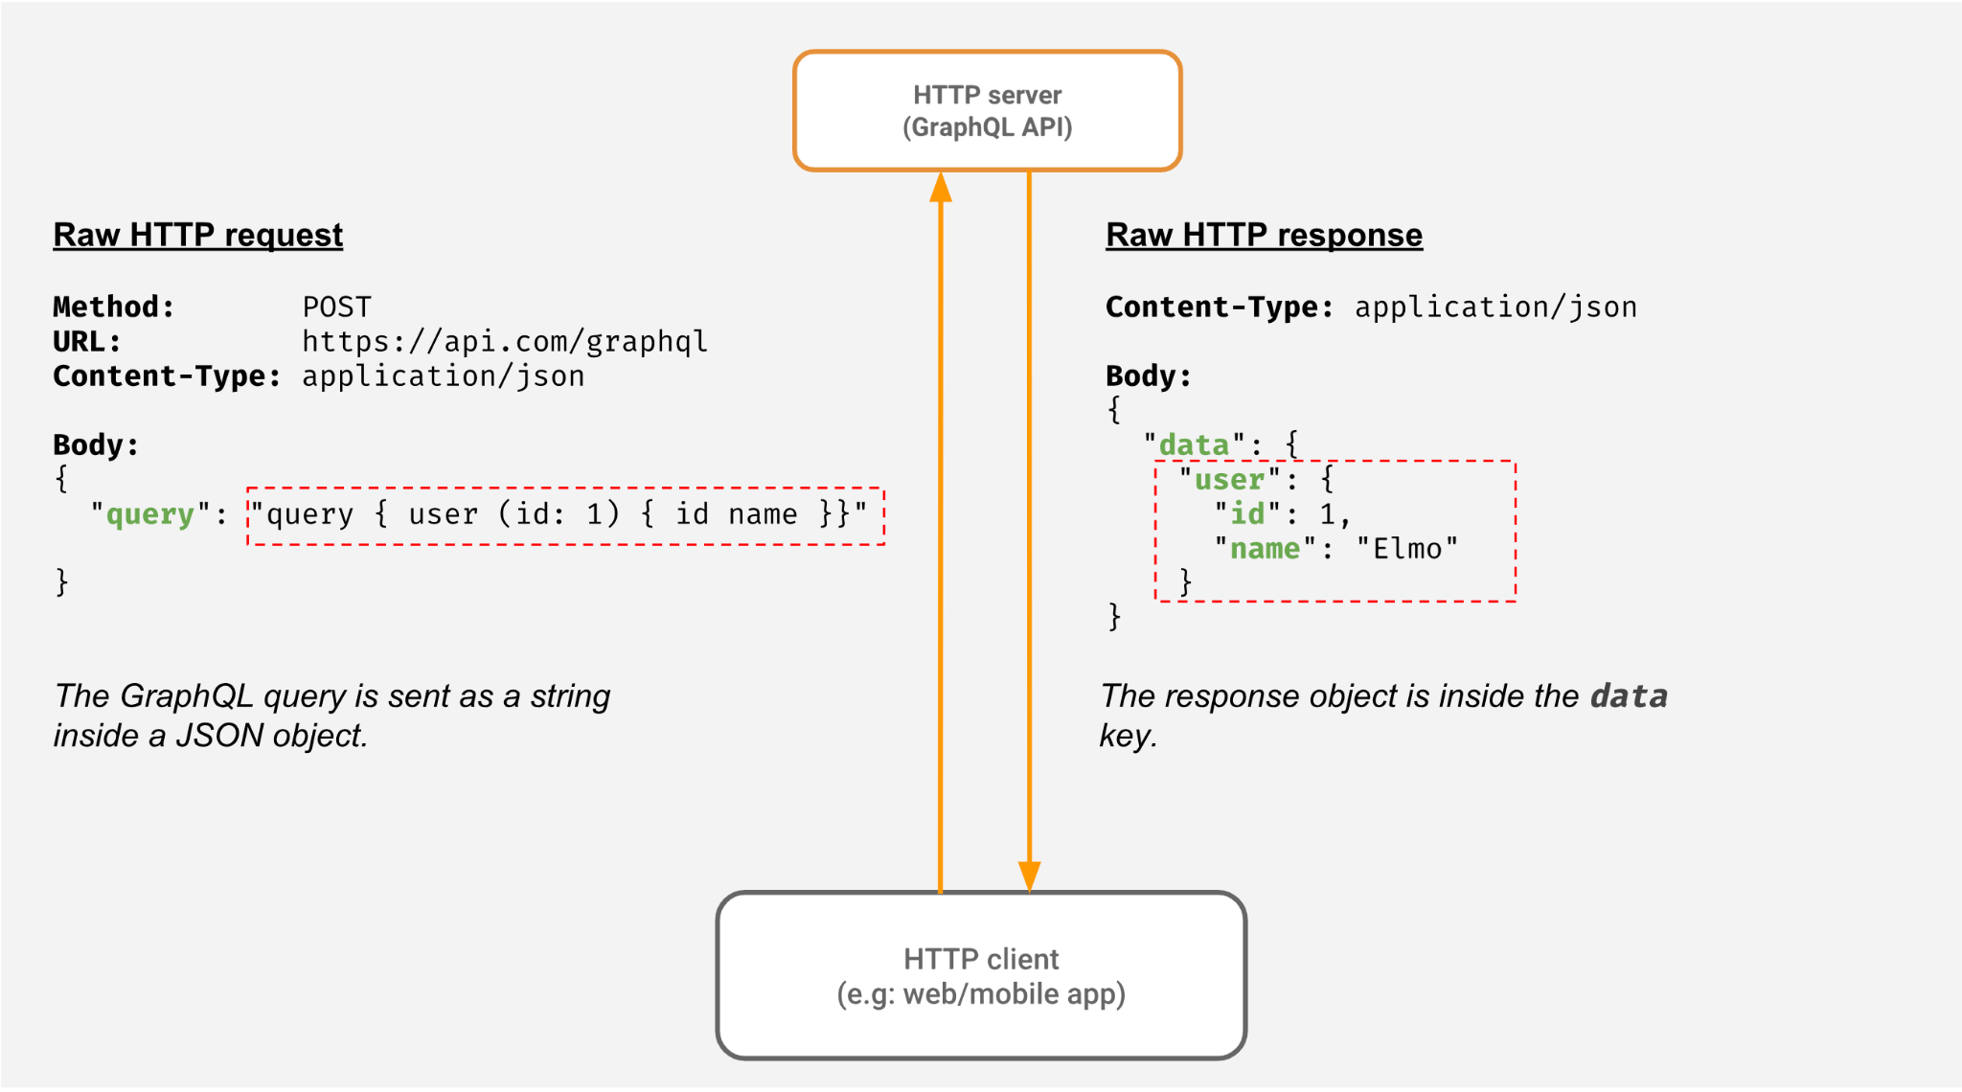

Slide 35
Falcor API style
Similar to GraphQL, Falcor APIs create a virtual JSON file that acts as a container for the data a client will receive after a request. This virtual file can be extended with every new piece of data the client needs. While this adds convenience, the file can become pretty big with time.
You don’t have to retrieve the whole JSON file with every request. Instead, you can specify which parts you need at any moment and get those in the response. This works because the JSON file is published under an URL and links to different resources in the backend. Essentially, you can navigate the virtual file for the data you want.
This virtual layer between the client and the server helps connect the two while keeping both their architectures completely independent.

Slide 36
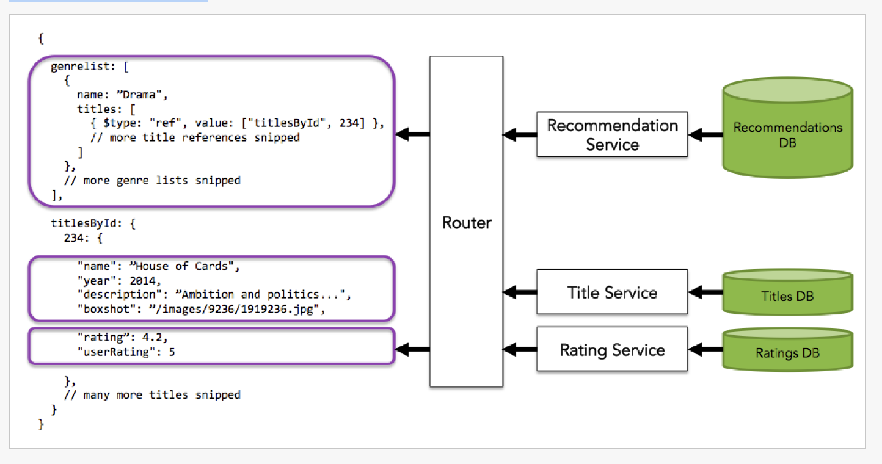
The Falcor Router allows you to expose a single JSON model to the client, while giving you the flexibility to store your data anywhere.

Slide 37
Differences between Falcor and GraphQL
https://www.apollographql.com/blog/backend/graphql-vs-falcor-4f1e9cbf7504/#differences

Slide 38
REST
The representational state transfer
Most popular approach to building APIs
REST relies on a client/server approach that separates front and back ends of the API and provides considerable flexibility in development and implementation
REST is stateless, which means the API stores no data or status between requests.
REST supports caching, which stores responses for slow or non-time-sensitive APIs.
REST APIs, usually termed RESTful APIs, also can communicate directly or operate through intermediate systems such as API gateways and load balancers.

Slide 39
REST principles
In a REST API design, client and server programs must be independent. The client software should only know the URI of the requested resource; it should have no additional interaction with the server application.
Layered System Architecture - Individual components cannot see beyond the immediate layer with which they are interacting.
Representation - Asking for a suitable presentation by a client is referred to as content negotiation (returns data in requested format)
Addressability - Each resource have unique identifier
Uniform interface - Each resource is accessed the same way
Statelessness - REST APIs are stateless, meaning each request must contain all the information needed to process it.
Cacheable - resources should be cacheable on the client or server side. The objective is to boost client-side speed while enhancing server-side scalability.

Slide 40
Comparing SOAP and REST
Organizations must select the most appropriate format based on the complexity of the information that must be exchanged, the level of security needed around that information and the speed or performance required from those exchanges.
For example, a simpler format might be easier to code and maintain but might not offer the level of security that an enterprise adopter requires. More complex formats might provide that security but pose higher learning curves for adopters or require more bug fixes and work from developers.
There are some common considerations for the major API formats.

Slide 41
Considering REST and SOAP,
Both formats are designed to connect applications and mainly utilize HTTP protocols and commands such as Get, Post and Delete. Both can use XML in requests and responses.
SOAP depends on XML by design, while REST can also use JSON, HTML and plain text.
SOAP is standardized with strict rules, while REST allows flexibility in its rules and is instead governed by architectures.
REST architecture treats every content as a resource. These resources can be Text Files, Html Pages, Images, Videos or Dynamic Business Data. REST uses various representations to represent a resource as Text, JSON, XML.

Slide 42
SOAP is used when an enterprise requires tight security and clearly defined rules to support more complex data exchanges and the ability to call procedures.
Developers frequently use SOAP for internal or partner APIs.
REST is used for fast exchanges of relatively simple data. REST can also support greater scalability, supporting large and active user bases. These characteristics make REST popular for public APIs, such as in mobile applications.

Slide 43
Examples of APIs in use today
Social media APIs - platforms such as Twitter and Facebook rely on APIs to handle communication between the platform and remote endpoints, including functions such as Twitter bots
Login and authentication APIs - Today's highly integrated software environments rely on APIs to provide some level of single sign-on. For example, one application might ask a user to "log-in using Facebook."
Widget and service APIs - APIs are commonly used to integrate a wide range of small features and functions.
For example, the weather report, ocean tide schedule, news feeds and other content that comes up in a web search is typically generated through APIs used by the search engine to varied service providers.
Other services such as Google Maps use an API to enable users to search locations or plan routes through their web browser, and APIs also allow maps to be included in countless third-party websites.

Slide 44
Financial and payment APIs - It's commonplace for a bank to rely on an API to connect remote users to the bank's back-end systems for remote deposits, balance checks, transfers and electronic payments.
Travel and booking APIs - Sites, such as Trivago and Expedia, use custom APIs to enable users to search and book a wide range of flights and accommodations. The site uses airline, hotel, car rental and other provider APIs from the back end.
Shipping and supply-chain APIs - Requires processing of Real time data to provide the status of a purchase and see any shipping details.
Content delivery and management APIs - Online content delivery platforms such as Spotify and Netflix rely on APIs to enable users to select desired content and then deliver that streaming content to the user's device for viewing, all while the provider maintains control over the content, which is never actually downloaded or stored on the user's device.

Slide 45
Microservices - Microservices allow a large application to be separated into smaller independent parts, with each part having its own realm of responsibility.
To serve a single user request, a microservices-based application can call on many internal microservices to compose its response.
It is not same as API. APIs can be made up, wholly or partially, out of microservices.

